Slide 1
Ebbing the Abyss: Higher Education’s Role in Promoting Financial Literacy
Mary K. Johnson
Financial Literacy and Consumer Advocacy Manager
Higher One, Inc.

Slide 2
Discussion Outline
Introduction
Why Financial Literacy matters
What it means for Higher Education
Becoming a champion

Slide 3
Perspective
“While freshman and their parents are likely thinking more about tests and academics during orientation, the fact is that after graduation a student’s credit rating is arguably far more important to his or her future than grade point averages.”
Robert D. Manning, PhD,, Author – Credit Card Nation
Research Professor and Director of the Center for
Consumer Financial Services
Rochester Institute of Technology

Slide 4

Reality for Students
Inexperienced with money management
Have trouble controlling their spending
Taking on too much debt
Serious post-college consequences

Slide 5

College and Universities
Public Purpose
Financial Consequences
Accountability and Reputation

Slide 6
Public Purpose
Prepare well-educated and productive citizens
Address societal problems
Financial Literacy is the next problem
“State colleges and universities have a unique opportunity to provide leadership on this critical topic by weaving financial education into the fabric of their campus.”
AASCU – Fall 2010
Notes:
All liberal arts colleges — but especially those colleges enrolling classes with more first-generation college students than ever before — have an obligation to ask how we can continue to improve the experience of gaining financial literacy and those outcomes for our students. We must do this as institutions concerned with transparency, accountability and access, and as institutions whose primary and time-honored concern is to educate the whole person. President Steve Bahls – Inside Higher Education June 17th.

Slide 7
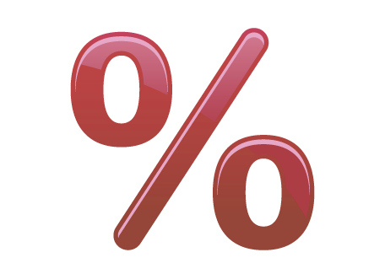
Sobering Statistics
  % of students who pay off credit card debt each month
      Less than 20% (Sallie Mae 2009)
  Average unpaid balance upon
  graduation
      $4,100 (Sallie Mae 2009)
  Average student loan debt upon graduation
      $24,000 (The Project on Student Debt 2010)
  College graduate bankruptcy rate
    Up 20% over last 5 years (Institute for Financial Literacy 2011)
  Percent of students late on credit card payments
      42% (Higher One Financial Literacy Survey 2011)
Notes:
It’s not just the US, A recent study in China found that 70% of students said they need to increase their knowledge of personal finance. 15% were unable to break even.

Slide 8
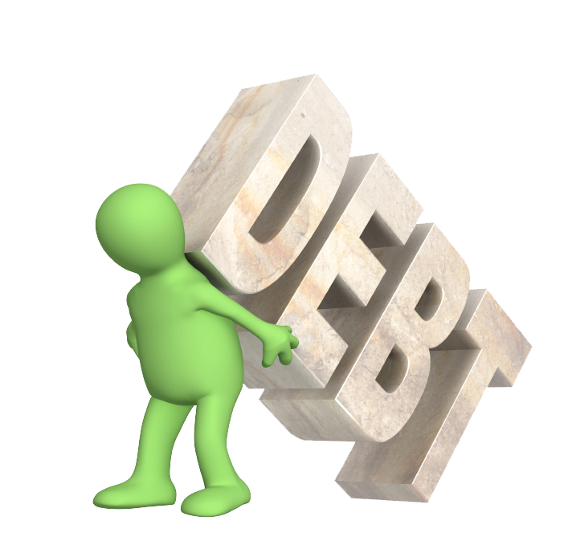
…And They Are Not Alone
Persistently high unemployment
Average household credit card debit - $15,788 (Federal Reserve)
30% live paycheck to paycheck (Harris Poll)
4 in 5 Americans will fall short of meeting their retirement needs (Hewitt Associates 2008)
40% grade their personal finance knowledge at “C” or below
Notes:
For those 40% of households that carry a balance from month to month

Slide 9

Financial Incentives
Cost Efficiency
    Cheaper to keep students than recruit new ones
Short-Term Revenue Losses
    Delay in enrollment, attend 2-year institutions, drop out or reduce course load
    37% drop out because of finances
Long-Term Revenue Implications
    Default prevention – Florida 10.5%
    Tomorrow’s alumni and future parents
Notes:
The latest figures from the USDE – cohort default rates have risen to 8.8%, up from 7% in 2008. In Texas, the rate is 10.1%
The Institute for Higher Education Policy looking at students who went into repayment from 2004 to 2009, found that 40 percent fall behind on their payments at some point in the first five years of repayment.
“In the coming years, a lot of people will still be paying off their student loans when its time for their kids to go to college.” Steve Kantrowitz, publisher of FinAid.org.
Student default rate no 8.9% up from 7% last year. (Public 7.3; independent 4.7)

Slide 10

Accountability and Reputation
Improve persistence, retention and graduation rates
Reputation
    Future parents and students
    Alumni that support your institution
    Businesses that hire your graduates

Slide 11
FL Now a Work Requirement

Slide 12
What is Financial Literacy?
Knowing
    How much $ you have
    How much $ you will require
    How to grow and protect your $
Understanding
    Financial concepts
    Financial products
Making Informed Decisions

Slide 13
Key Financial Literacy Elements
Cash management and budgeting
Credit cards
Debt management
Net worth
Savings and investing
Credit scores
Identity protection

Slide 14
Taking Action
Courses
Dedicated websites
Workshops, seminars, special events
Peer to peer counseling
Social media outlets
Money management centers
Full online programs

Slide 15
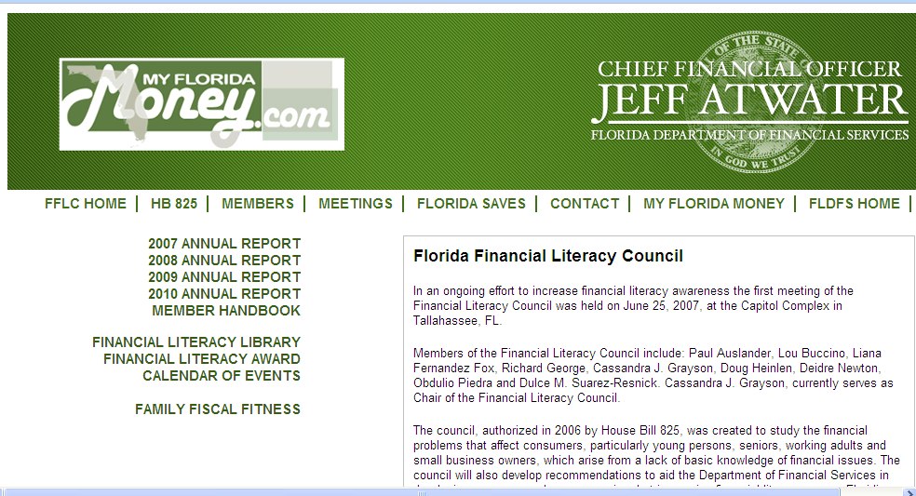
Florida’s Efforts

Slide 16
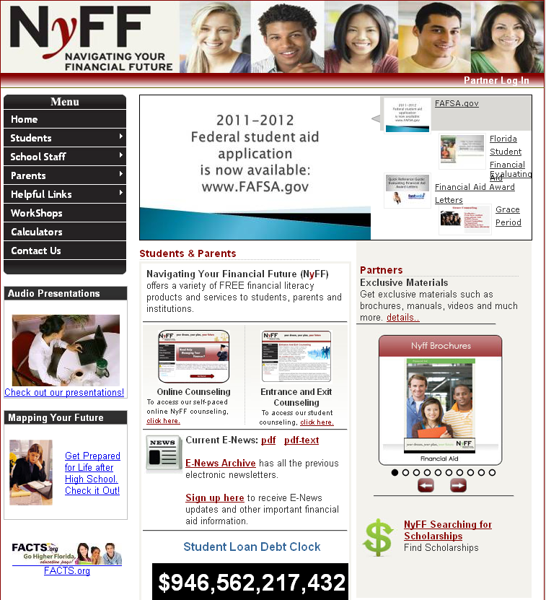
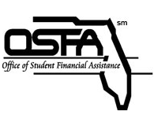

Slide 17
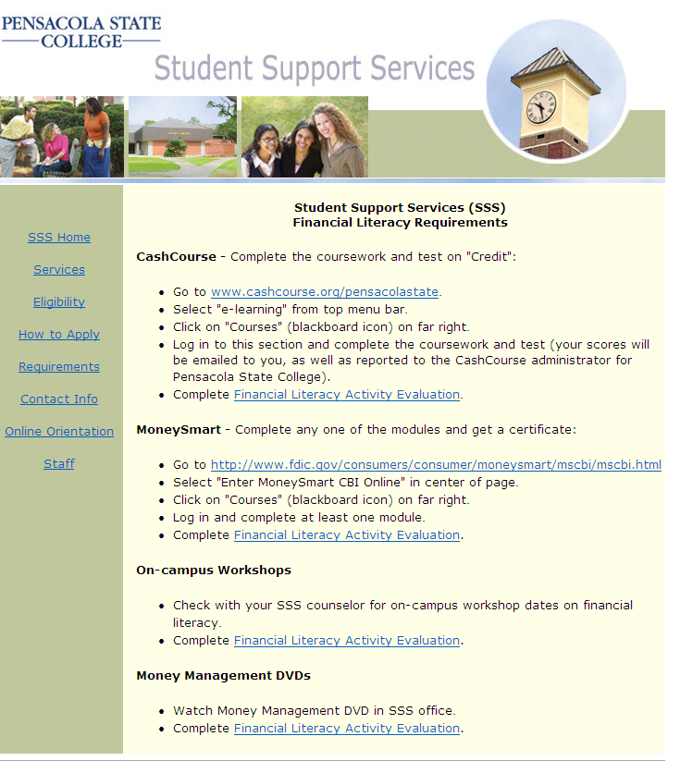

Slide 18
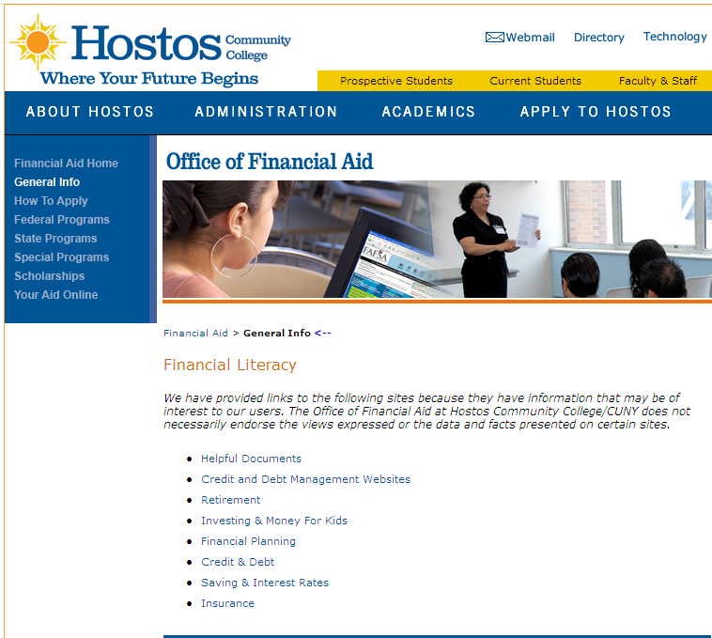

Slide 19
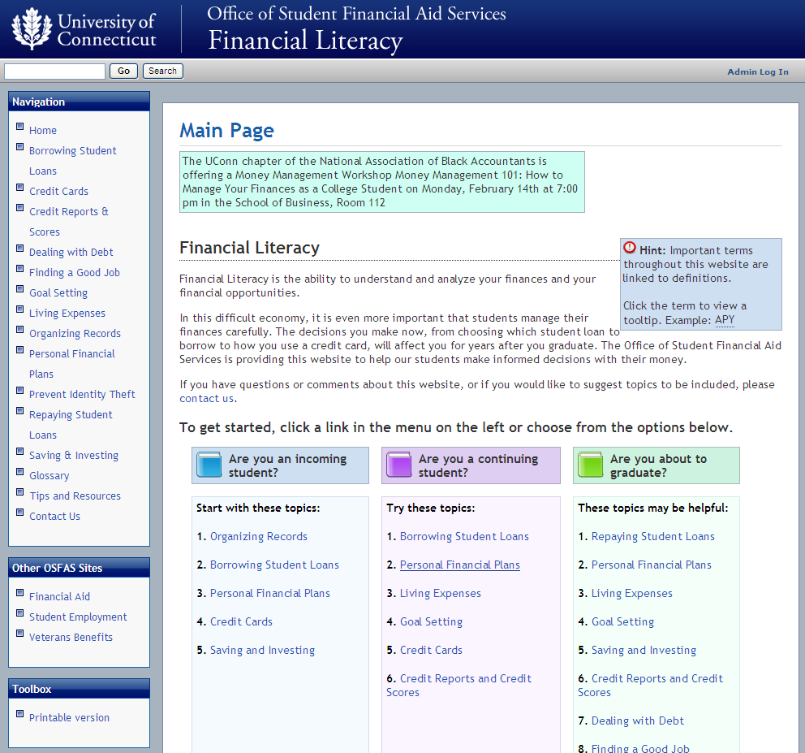

Slide 20
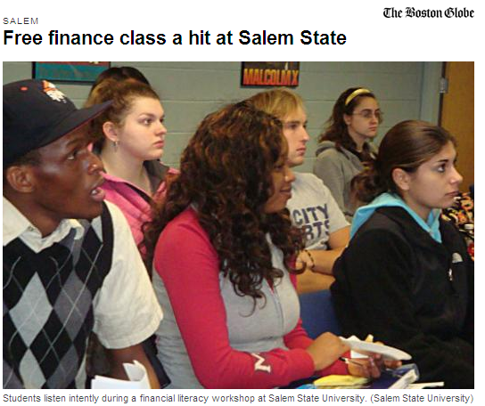
Workshops and Seminars
March 3. 2011

Slide 21
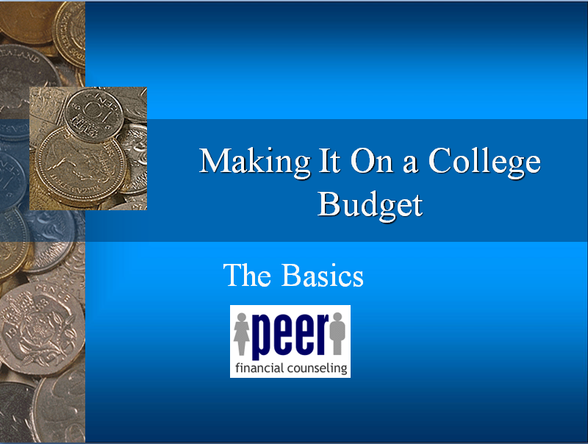
Peer to Peer Counseling
University of Georgia
University of Georgia

Slide 22
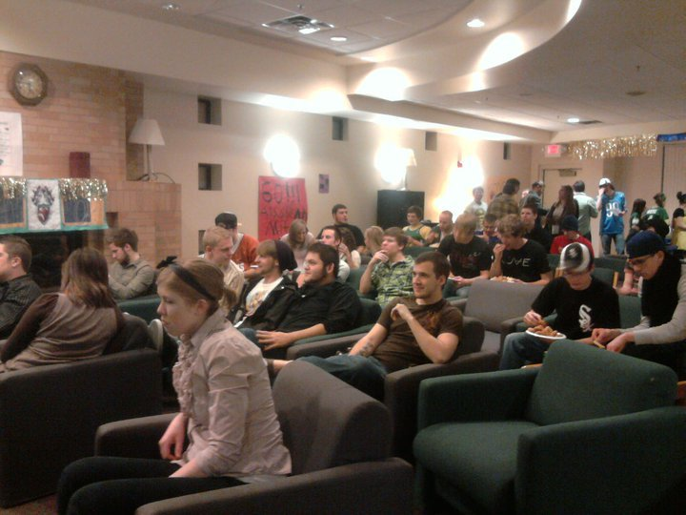
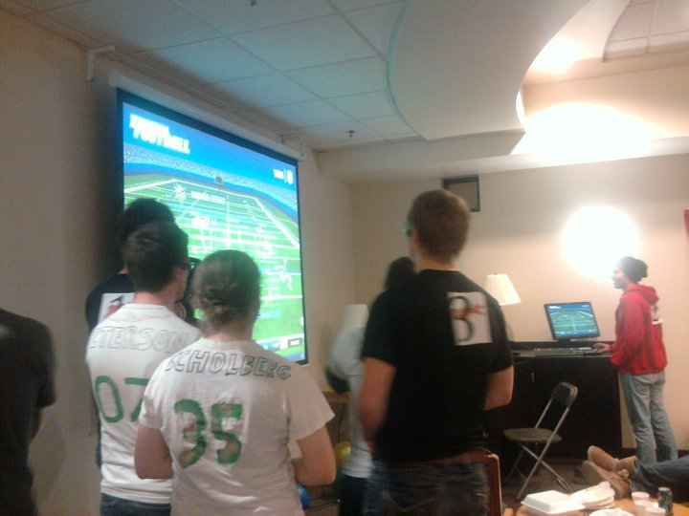
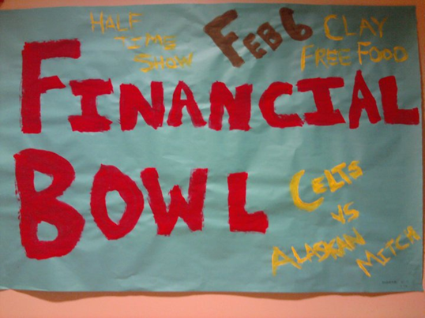
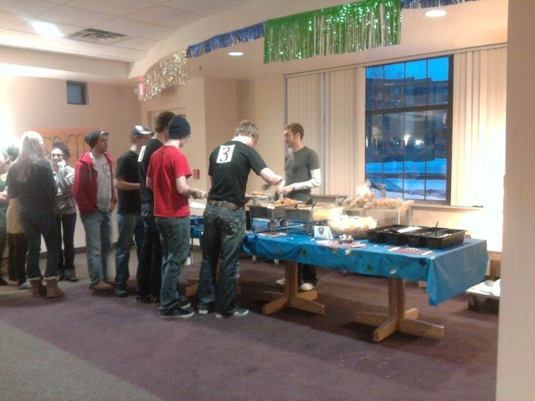
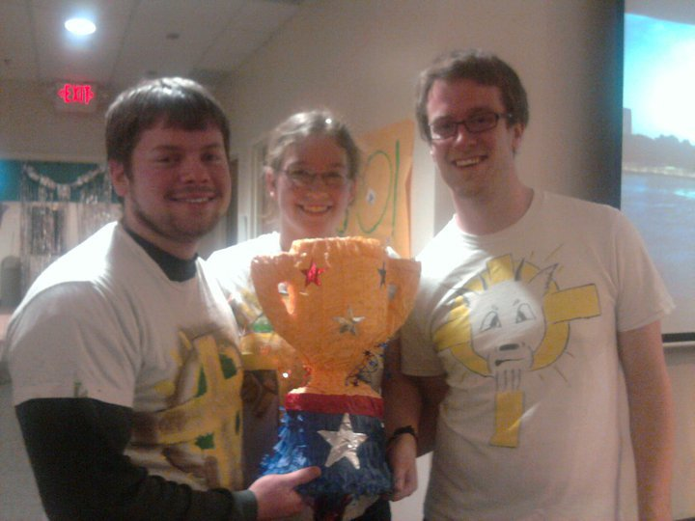
Make it Fun!

Slide 23


Social Media
Facebook
Blogs
Twitter
Contests
Video
Examples

Slide 24
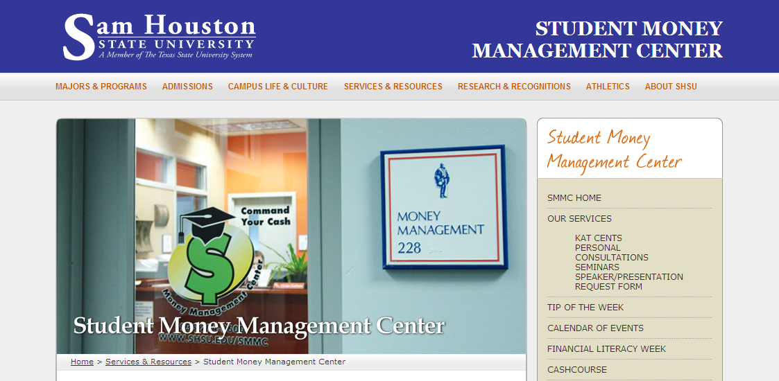
Money Management Centers

Slide 25
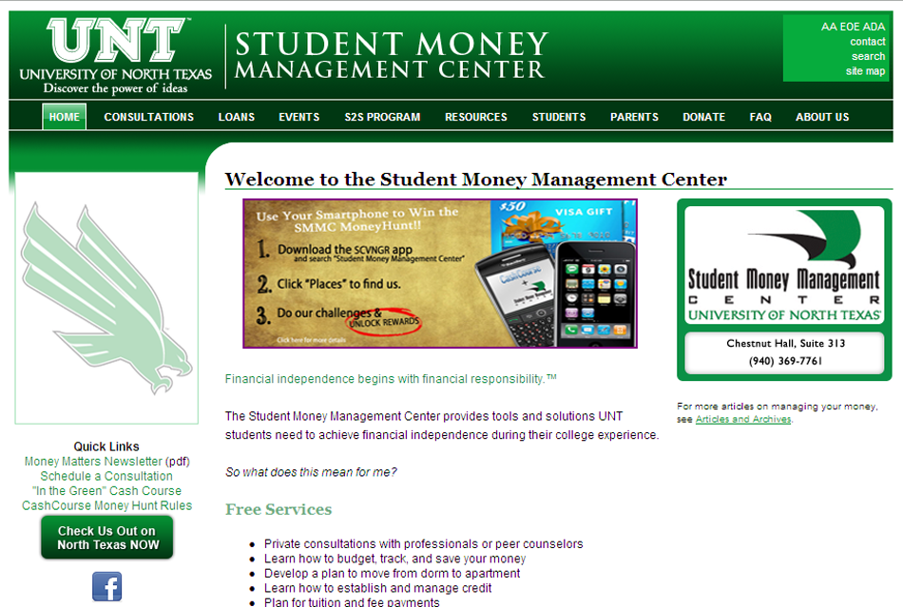
Money Management Centers

Slide 26











Online Programs

Slide 27

What to Look For
Interactive
    Games
    Real life experiences
Engaging
Cost effective
Flexible
Administrative tools
Evaluation tools

Slide 28

Tips for Getting Started
Identify your advocates
Start small
Know your students
Embrace financial literacy as part of your mission
Choose engaging and high quality content and delivery methods
Assess what you are doing

Slide 29

Add to the Knowledge Base
What learning environments are most effective?
What concepts are most relevant to students?
What is the best time to introduce them?
Arizona APLUS study

Slide 30


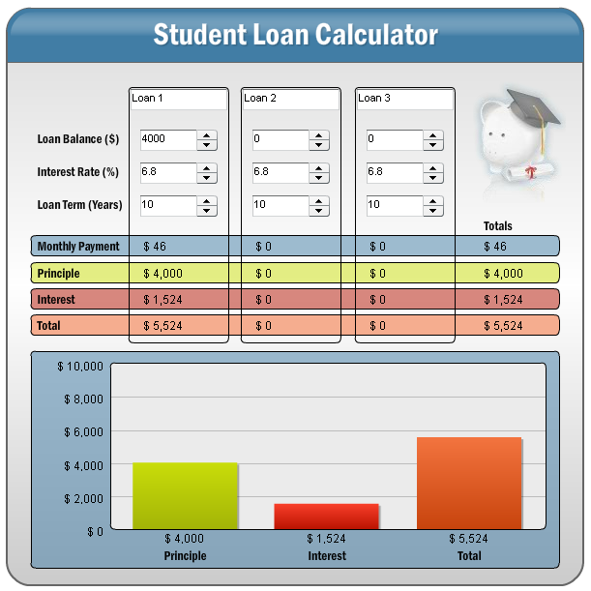
Higher One’s commitment
Dedicated Financial Literacy Resource
One for Your Money
  Bi-weekly blog posts
  Money on My Mind
  Words of Financial Wisdom
  Financial Literacy Month Challenge
  of the Week
MoneyTalkMary

Slide 31

Financial Literacy Counts Grant
80 applications from across the country
$30,000 provided to 8 institutions
Activities to take place this fall
Stayed tuned for program results

Slide 32
Financial Literacy Quiz
Answers
1. D | 11. B
2. B | 12. C
3. C | 13. D
4. D | 14. C
5. B | 15. A
6. C | 16. C
7. B | 17. C
8. B | 18. D
9. D | 19. C
10. B | 20. B

Slide 33
Recap
Financial literacy affects all of us
Short term and long term consequences
Be more proactive by:
    Making it part of your mission
    Knowing what your students require
    Choosing engaging content and delivery methods
    Evaluate and add to the knowledge base

Slide 34

Questions?
Visit: http://www.higherone.com/oneforyourmoney
Follow me on Twitter: MoneyTalkMary

