Slide 1
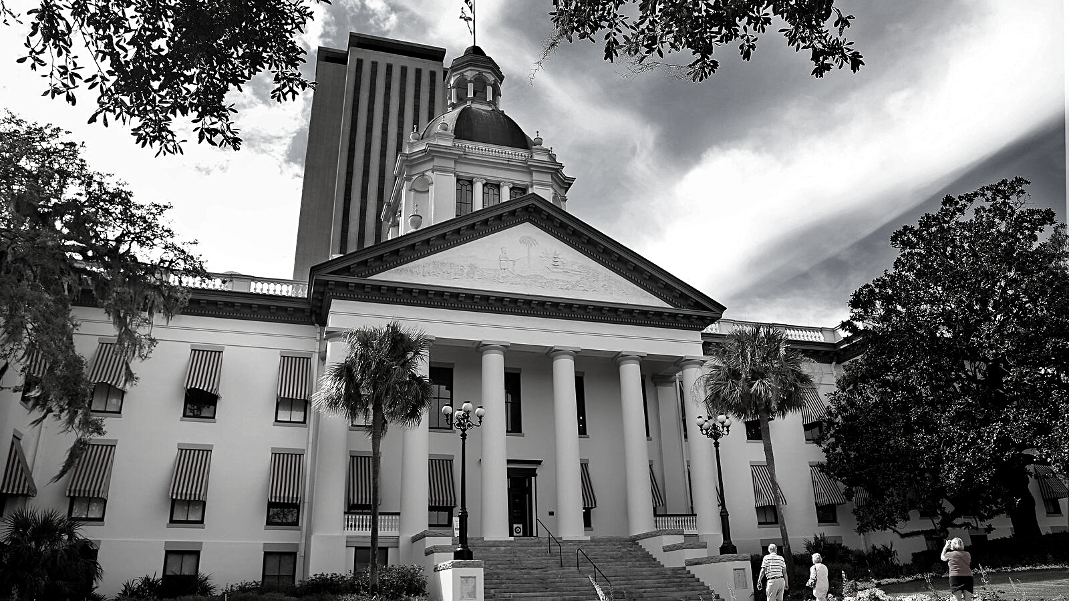
2024
LEGISLATIVE
UPDATE
2024
LEGISLATIVE
UPDATE

Slide 2
2024
Legislative
Update
2023 REGULAR SESSION DATES
Interim Committee Weeks
January 2 - 6
January 16 - 20
January 23 - 27
February 6 - 10
February 13 - 17 February 20 - 24
Session Dates
January 26 - House Bill Drafting Deadline
January 27 - Senate Bill Drafting Deadline
February 13 - House Appropriations Project Request Deadline
March 7 - Session Convenes; Bill Filing Deadline

Slide 3
2024
Legislative
Update
SENATE LEADERSHIP
Sen. Passidomo, President
Sen. Baxley, President Pro-Tem
Sen. Albritton, Majority Leader
Sen. Book, Minority Leader
Sen. Broxson, Appropriations
Sen. Perry, Education Appropriations
Sen. Grall, Postsecondary Education
Sen. Mayfield, Rules

Slide 4
2024
Legislative
Update
HOUSE LEADERSHIP
Rep. Renner, Speaker
Rep. Clemons, Speaker pro tempore
Rep. Grant, Majority Leader
Rep. Driskell, Minority Leader
Rep. Leek, Appropriations
Rep. Shoaf, Higher Education Appropriations
Rep. Massullo, Education & Employment
Rep. Melo, Postsecondary Education & Workforce
Rep. Perez, Rules

Slide 5
2024
Legislative
Update
COLLEGE LOBBYISTS
Advocate
Information resource
Voice of the institution
Develop strategy

Slide 6
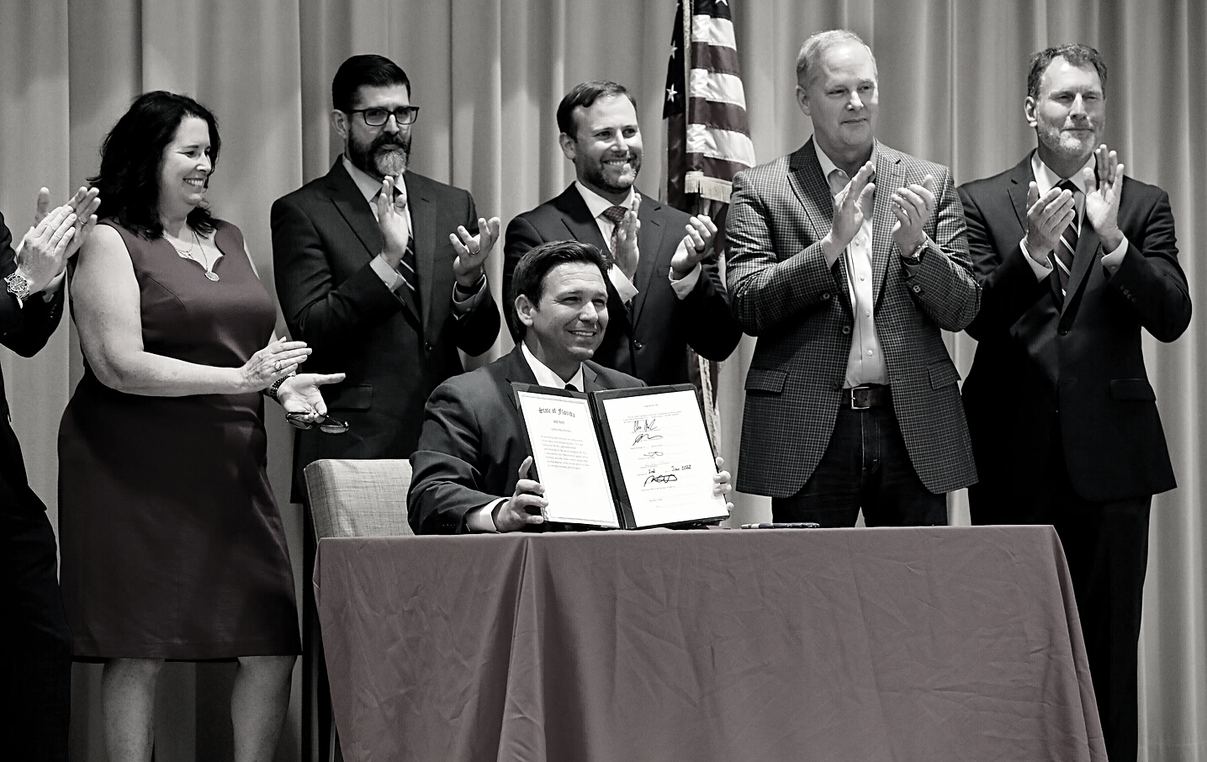
2024
Legislative
Update
GENERAL APPROPRIATIONS ACT
$110 Billion
$48.8 b - Health and Human Services
$29 b - Education
$12.6 b - Transportation
$7.6 - General Government
$6 b - Courts and Criminal Justice
$6 b - Environment

Slide 7
2024
Legislative
Update
2023-24 BUDGET OUTLOOK
REVENUE
$5.3 b in additional revenue projected in FY 2022-23 and 2023-24
$9.1 b in additional funds than previously expected
SURPLUS
$13.5 b for FY 2023-24
Recurring base budget, increased workload (PreK-12, Medicaid), average cost increases, restoration of nonrecurring funding

Slide 8
2024
Legislative
Update
2023-24
LEGISLATIVE BUDGET REQUEST
September 2022 - Approved by the State Board of Education
October 2022 - Submitted to the Executive Office of the Governor
February 2022 - Governor's Budget Released
FLDOE Legislative Budget Request
$114.8 Billion
$47.5 b - Health and Human Services
$30 b - Education
$19.8 b - Transportation
$3.6 - General Government
$6.5 b - Courts and Criminal Justice
$6.7 b - Environment

Slide 9
2023-24 GOVERNOR'S PROPOSAL
$1.19 b
$59 m
Program Fund
PIPELINE LINE
2022-23 HIGHLIGHTS
$30 m
$15 m
Student Success Grant
Open Door Grant
$1.38 b - Program Fund
$59 m - PIPELINE/LINE Grants
$30 m - Student Success Grant
$20 m - Open Door Grant
$14 m - Industry Certifications
$18 m - DE Scholarship
$184 m - Capital Projects
$395 m - Deferred Maintenance
$20 m
$18 m
Industry Certifications
DE Scholarship
$93 m
$137 m
PECO
PECO Maintenance

Slide 10
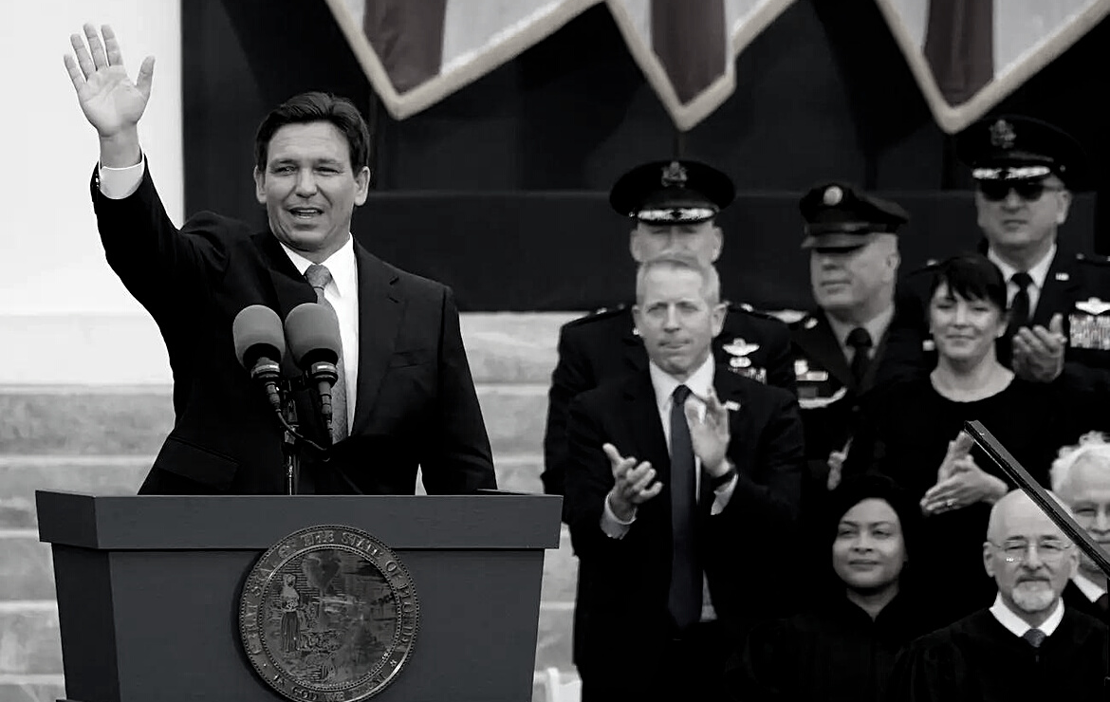
2024
Legislative
Update
FREEDOM BLUEPRINT
Banning mask and vaccine mandates
Sales tax cuts
Banning China from buying farmland and residences
Cracking down on teachers' unions
Prescription drug price transparency
FDOT infrastructure support
Higher Ed reform
Finalizing changes to Disney special tax district

Slide 11
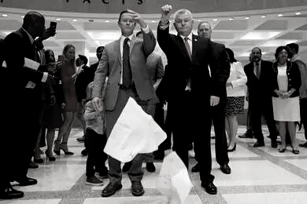
2024
Legislative
Update
HOUSE AND SENATE POLICY INTERESTS
Addressing inflation through tax reductions
Affordable housing
Constitutional carry
Fuel and utility bill relief
Parental rights in education
School choice

Slide 12
2024
Legislative
Update
POLICY ISSUES
Special Session 2022A
Insurance Market Reforms
Disaster Relief
Toll Relief
Special Session 2023B
Election-related crimes
Transportation of Inspected Unauthorized Aliens
Intercollegiate Athlete Compensation and Rights
Reedy Creek Improvement District

Slide 13
2024
Legislative
Update
BILLS FILED
HB 7B - Intercollegiate Athlete Compensation and Rights (Passed)
SB 274 - Nursing Education Pathway for Military Combat Medics (HB 517)
HB 311 - Postsecondary Intellectual Freedom and Viewpoint Diversity (SB 324)
HB 465 - Workforce Education (SB 630)
HB 595 - Determination of Residential Status for Tuition Purposes (SB 526)
HB 679 - State University and State College Agreements with Foreign Countries of Concern
SB 732 - Collegiate Purple Star Campuses
SB 744 - Emergency Medical Services Training Programs (HB 787)
SB 750 - Articulation Agreements

Slide 14
2024
Legislative
Update
QUESTIONS?

