Slide 1
Local Solutions to the National Attainment Challenge
Near Grad Full Circle

Slide 2
The Opportunity: The Power to Know
Near Grad is an HCC-designed SAS Business Intelligence (BI) application developed in 2013 that identifies current or former students within a semester or less of degree attainment.
The effort begins to gain attention in 2015 …
(and HCC wins the Excellence in Education Award at the 2017 SAS Global Forum
as well as Texas A&M University)

Slide 4
The Opportunity: The Power to Know
Pilots to execute Near Grad have been attempted, but large-scale, college-wide, sustainable processes have been elusive.
Winning Back Stop-Outs, Helios Education Foundation and UF College of Education

Slide 5
A Solution: The confluence of BI and AI
AdmitHub develops an Artificial Intelligence (AI) driven chatbot or virtual advisor that converses via text messaging, social media, website, etc.
AI brain becomes smarter as it engages with students. Available 24/7.
AI augments the professional cadre of the institution.

Slide 6
SAS BI, Meet AdmitHub AI
Near Grad application updated nightly. Data manipulation & immediacy are critical to effective AI application.
BI feed into AI of targeted student cohorts.
AI is deployed to engage Near Grads, provide solutions tailored to specific student needs, and facilitate re-enrollment to completion.
AI is branded “Gwen” after our sixth president, the late Dr. Gwendolyn Stephenson.

Slide 7
Near Grad Cohort:
Students last enrolled fall 2018 through fall 2019 -
Did not enroll spring 2020, summer 2020, or register for fall (at time of SAS VA query)
Within 15 credit hours or less of degree completion.

Slide 8
Near Grad by the Numbers
2,629 Near Grads identified by SAS VA
2,380 with valid phone # approached by
Gwen AI via text
1,911 opt in
651 engage Gwen, 34%
187 re-enroll fall, 29%
# that graduate ?

Slide 9
So, what happened to the 187 Near Grads that re-enrolled in fall 2020?
81% (151) had a positive outcome
41 completed degrees.
70 completed courses and re-enrolled this spring 2021.
40 completed courses with GPA >2.0 and did not enroll spring.
36 completed courses with GPA < 2.0 and did not enroll spring.

Slide 10
Barriers to Near Grad Completion:

Slide 11
Common response:

Slide 12
Continued Evolution
August 2020:
Gwen reaches out to Near Grads offering free Knack peer-to-peer online tutoring and supplemental instruction.
Gwen lets Near Grads know she speaks Spanish and other languages.

Slide 13
2021 Spring Campaign
Gwen supports Near Grads that returned in fall 2020 and re-enrolled spring 2021.
Gwen deploys new campaign to Near Grads last enrolled spring 2020.
Gwen lets students know credits remaining, but also toward what degree.

Slide 14
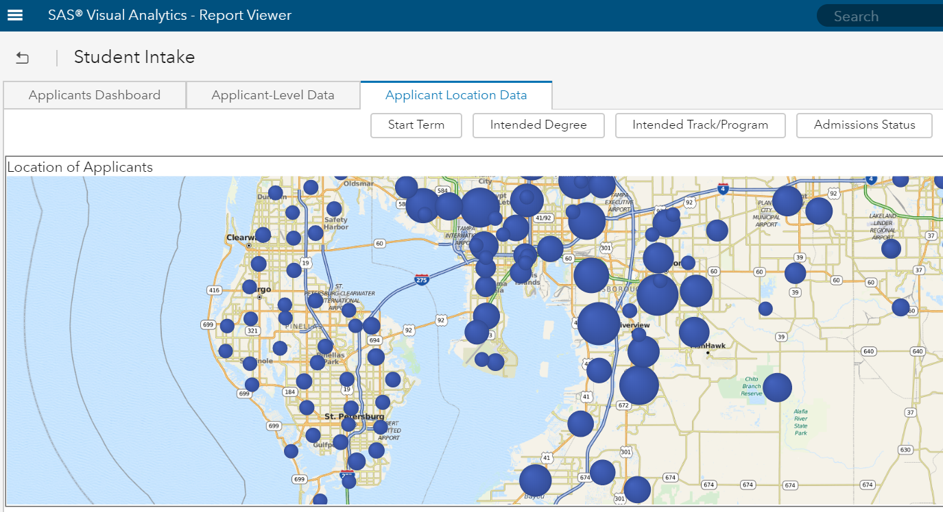
Next Steps: Beyond 2020
Expand to other BI/AI usage. Expansion is project driven with clear objectives, not a communication tool per se.
Applicant recruitment.
Reversal of summer melt.
Guide students to completion.

Slide 15
Local Solutions to the National Attainment Challenge
Near Grad Full Circle

